Slide 1
HINY
Opensource Professional Project (Prof.Kyung soon, Hwang)
Help Is always Near You
Team Lazy Cheetah

Slide 2




Team Lazy Cheetah
Minwoo, Cho
Jaehong, Nam
Seokhyeon, Yun
Junhyeon, Sim
Team Leader
Project Manager
Algorithm Designer
Fullstack Developer
Team Member Data Analyst
Back-end Developer
Team Member API Designer
Back-end Developer
Team Member App Designer
Front-end Developer

Slide 3
TABLE OF CONTENTS
01.
02.
03.
04.
Project Subject
Project Target
What is project HINY?
Who needs this project?
Deferentiate
System Introduction
Differentiate from other application
Introduction to project HINY
05.
Future Feature
What can be add our project?

Slide 4
Project Subject
Project HINY is an Android application that analyzes the medicines needed in case of emergency and recommends medicines stores.

Slide 5
Project Target
· Nighttime emergency patients
· Patients who can't get to the hospital
· Patients in rural areas with no pharmacy nearby
· People who want to travel

Slide 6
Deferentitate
ConnectDI
HINY
Medicines Full Management Web Site
Low accessibility to the public
Can't access emergency medicine in smartphone
Only Management Emergency Medicine
High accessibility to the public
Works in smartphone

Slide 7
System Introduction
THIS IS HOW OUR PROJECT WORKS

Slide 8
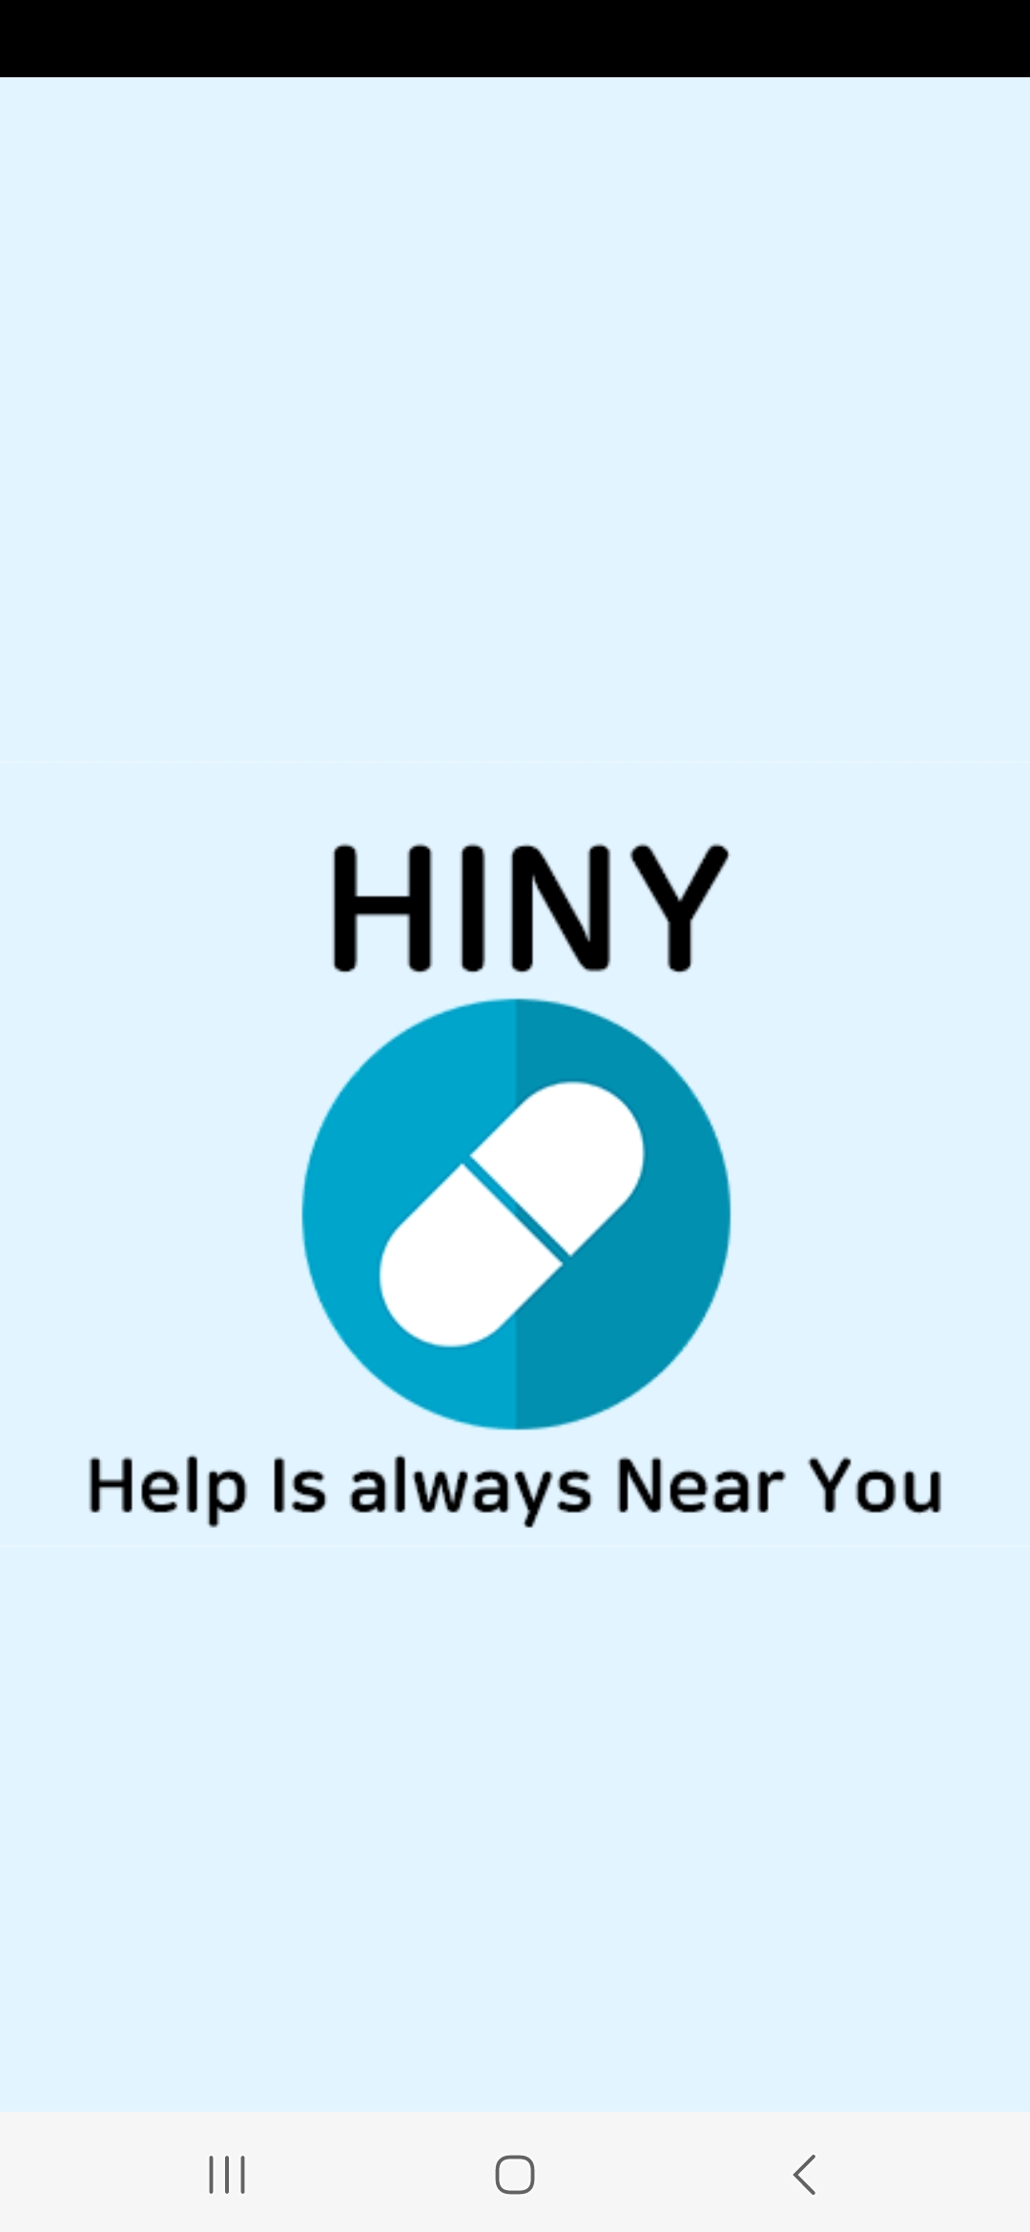
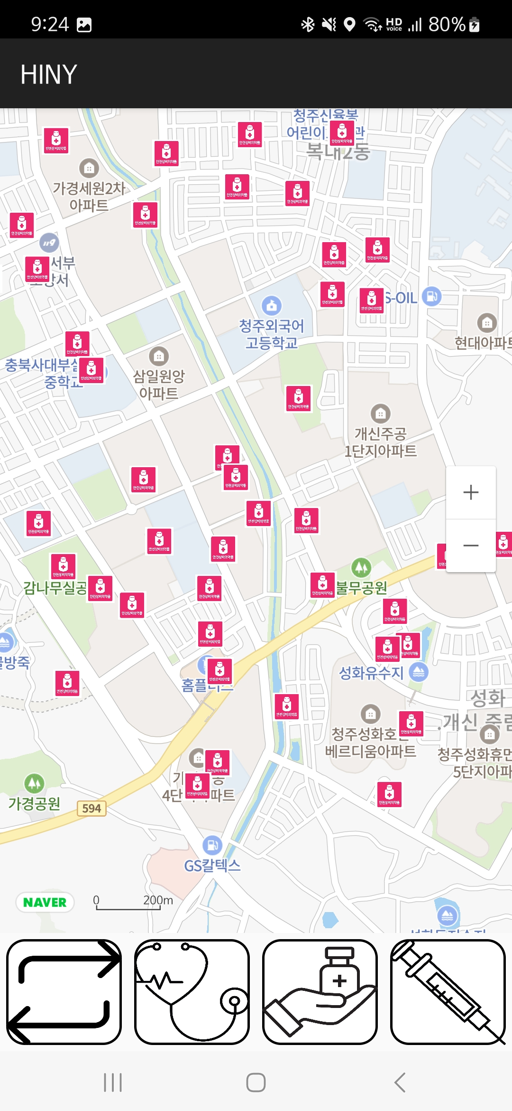
HOME
This screen displays emergency medicine store based on the user's location.
USED ALGORITHM
As a front-end
load map from naver map API
load buttons from code
create default markers from current place
get markers from DataBase
As a back-end
caculate 3km radius from current place
caculate x, y coord from database
send result to front-end

Slide 9
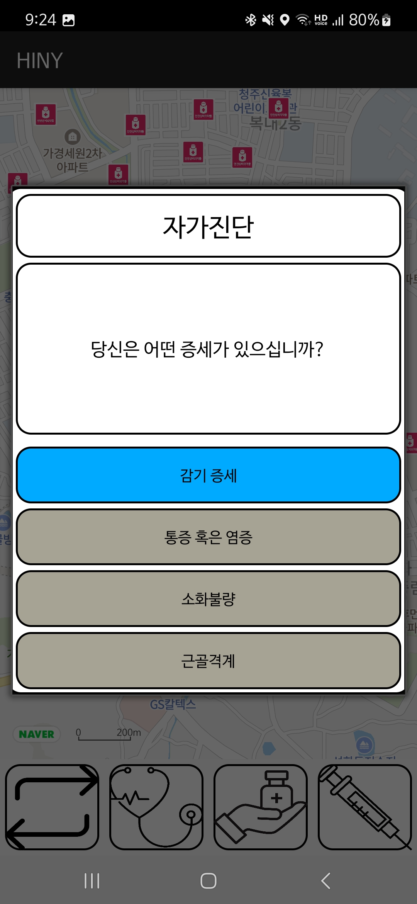
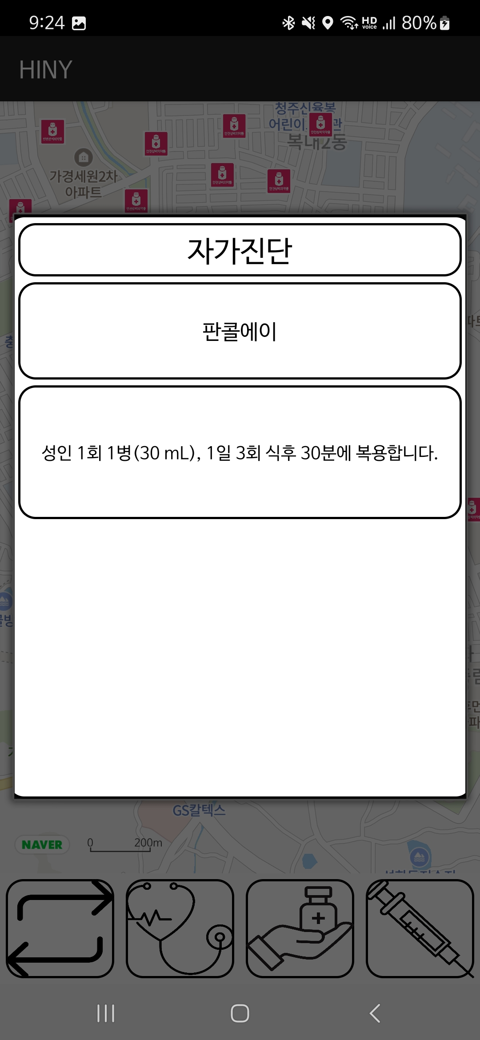
Self Test
On this screen, users can check their health status to see which medications are appropriate for their condition.
USED ALGORITHM
As a front-end
show popup with question and button
while user click button -> get next question
show medicine and information
As a back-end
if system display medicine and information
send logs to server

Slide 10
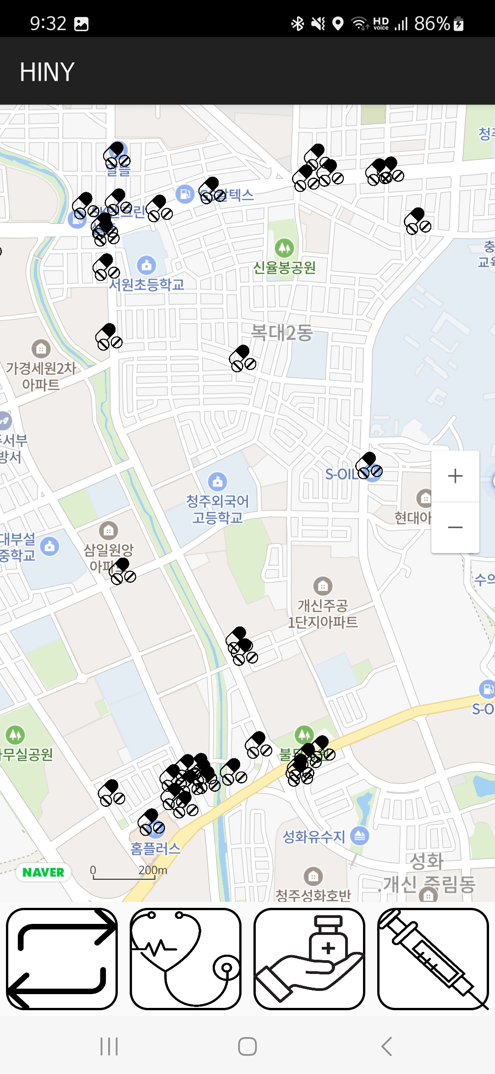
Lookup near store
This screen shows stores within a 2 kilometer radius around your current location.
USED ALGORITHM
As a front-end
get markers from DataBase
As a back-end
caculate x, y coord from database
send result to front-end

Slide 11
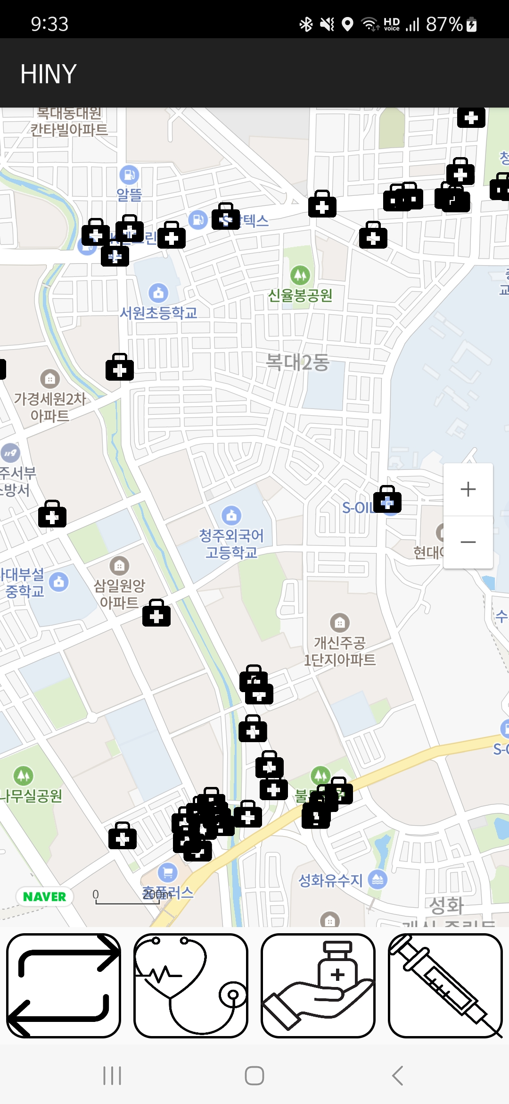
Lookup working hospital
This screen displays currently operating hospitals and pharmacies within a 2 kilometer radius around you.
USED ALGORITHM
As a front-end
get markers from DataBase
As a back-end
caculate x, y coord from database
send result to front-end

Slide 12
Future Feature
Design
I
Prototyping
F
What architecture we'll use?
Make some prototype to confirm our requirement
D
Implement
P
Feedback
What algorithm we'll use?
Feedback from other people to return Implement

Slide 13
Future Feature
Expectation
Substance abuse prevention
Reduce the number of emergency patients
Extension
Extending the architecture
Recommend to hospital specialties based on symptoms

Slide 14
THANKS!
Have any question?

